Slide 1
Module 5: Python Matrix
Sowmya Shah

Slide 2
Table of content
Aim and Objective
What is a Matrix?
Creating a Matrix using Python Lists
Accessing Element in a Python List
How to work with a nested list?
Matrix Addition using Nested Loop
Matrix Multiplication using Nested Loop
NumPy
What is SciPy?
Numpy VS SciPy
Did you know, Summary, reference links
Questions.
Sowmya Shah

Slide 3
Aim
Understanding Matrix manipulation
Case studies utilizing NumPy for various operations on matrix like Creating arrays, Indexing, Slicing.
Elaboration about various methods available with SciPy,
Objective
Matrix: creation, types and common operations using NumPy SciPy python libraries.
Sowmya Shah

Slide 4
What is a Matrix?
A matrix is simply a way of collecting data in rows and columns. We know data can be collected in sets, lists, etc.
When it comes to matrices, they are split into rows and columns. If you are not sure what the row and column are, the row is the horizontal axis.
The column on the other hand is the data seen in the vertical axis.
There is no straight way of representing a matrix data type in Python. The closest datatype to a matrix is the list data type, and thus, is typically used to create matrices.
The Numpy library provides another way of representing matrices in Python, the NumPy array data type.
Sowmya Shah

Slide 5
Creating a Matrix using Python Lists
#create a one-dimensional list list_1 = [1, -9, 0] #create a list with more than one row list_1 = [['first row'], ['second row'], ['third row'], ... ['last row’]]
3 by 2 matrix using nested lists: list_1 = [[8, -1], [0, 6], [5, 9]]
Sowmya Shah

Slide 6
3 by 2 matrix using nested lists
list_1 = [[8, -1], [0, 6], [5, 9]]
Sowmya Shah

Slide 7
Accessing Element in a Python List
#create a 3 by 2 list list_1 = [[2, -1], [0, 5], [4, 9]] #print the first row print(list_1[0])
Sowmya Shah

Slide 8
Accessing Element in a Python List
#create a 3 by 2 list list_1 = [[2, -1], [0, 5], [4, 9]] #print the element in the first row and second column print(list_1[0][1])
Sowmya Shah

Slide 9
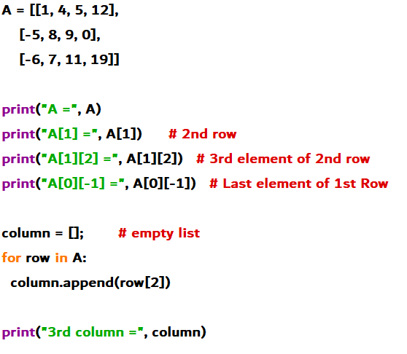
How to work with a nested list?
Sowmya Shah

Slide 10
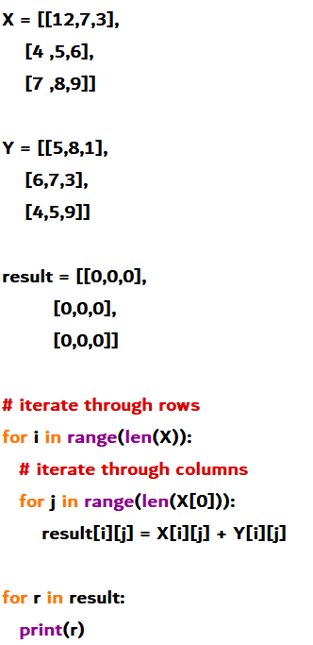
Matrix Addition using Nested Loop
Sowmya Shah

Slide 11
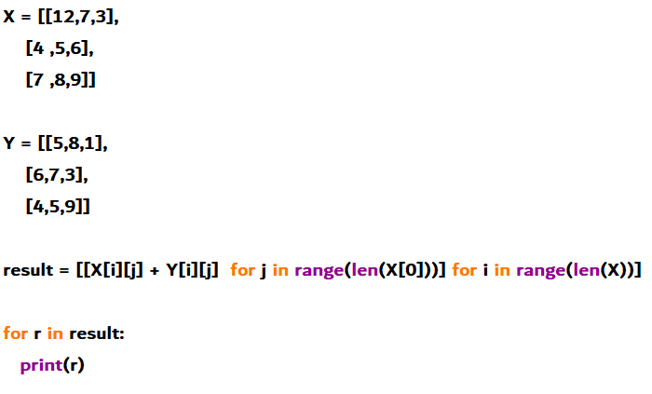
Matrix Addition using Nested List Comprehension
Sowmya Shah

Slide 12
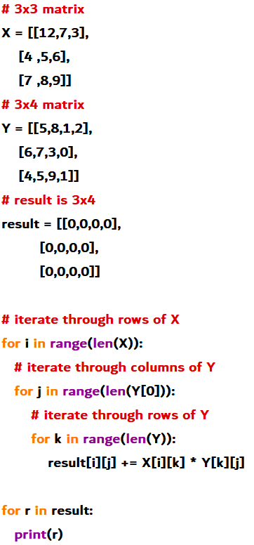
Matrix Multiplication using Nested Loop

Slide 13
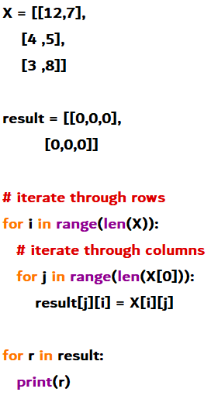
Matrix Transpose using Nested Loop
Sowmya Shah

Slide 14
NumPy
NumPy is a general-purpose array-processing package. It provides a high-performance multidimensional array object, and tools for working with these arrays. It is the fundamental package for scientific computing with Python. It is open-source software. It contains various features including these important ones:
A powerful N-dimensional array object
Sophisticated (broadcasting) functions
Tools for integrating C/C++ and Fortran code
Useful linear algebra, Fourier transform, and random number capabilities
Sowmya Shah

Slide 15
NumPy Array
NumPy Array: NumPy is a package for scientific computing which has support for a powerful N-dimensional array object.
NumPy provides multidimensional array of numbers (which is actually an object)
NumPy's array class is called ‘ndarray’
Why use NumPy?
Python lists are slower than NumPy arrays, which are also smaller. The use of an array saves memory and is simple. NumPy offers a means for specifying the data types and utilizes significantly less RAM to store data.
Sowmya Shah

Slide 16
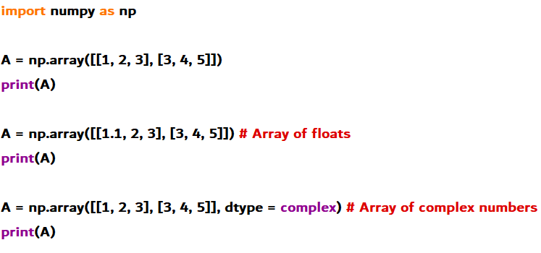
How to create a NumPy array?
1. Array of integers, floats and complex Numbers
Sowmya Shah

Slide 17
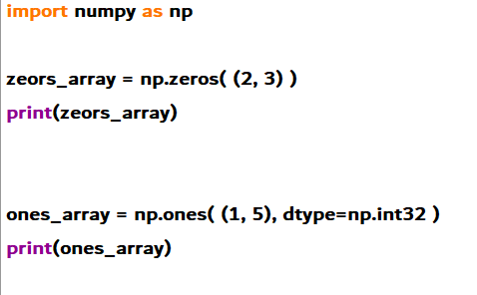
2. Array of zeros and ones
Here, we have specified dtype to 32 bits (4 bytes).
Sowmya Shah

Slide 18
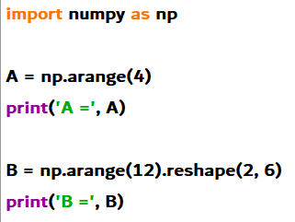
3. Using arange() and shape()
Sowmya Shah

Slide 19
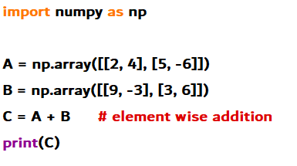
Addition of Two Matrices
We use + operator to add corresponding elements of two NumPy matrices

Slide 20
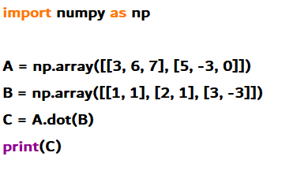
Multiplication of Two Matrices
To multiply two matrices, we use dot() method. Learn more about how numpy.dot works.
Note: * is used for array multiplication (multiplication of corresponding elements of two arrays) not matrix multiplication.
Sowmya Shah

Slide 21
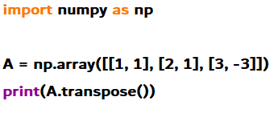
Transpose of a Matrix
We use numpy.transpose to compute transpose of a matrix.
Sowmya Shah

Slide 22
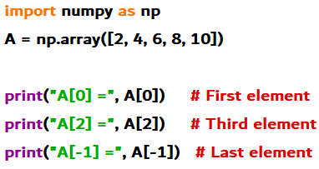
Access matrix elements
Similar like lists, we can access matrix elements using index. Let's start with a one-dimensional NumPy array.
Sowmya Shah

Slide 23
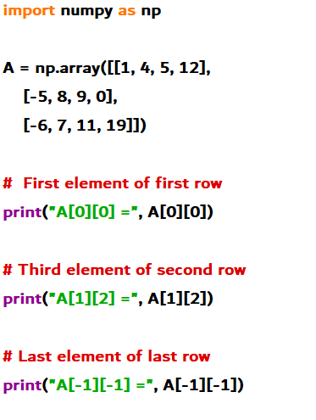
Access matrix elements
Sowmya Shah

Slide 24
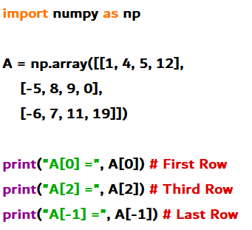
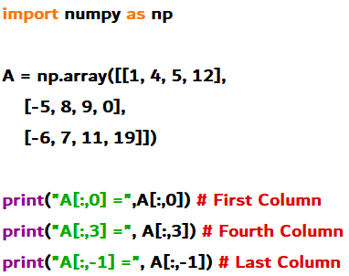
Access rows of a Matrix | Access columns of a Matrix
Sowmya Shah

Slide 25
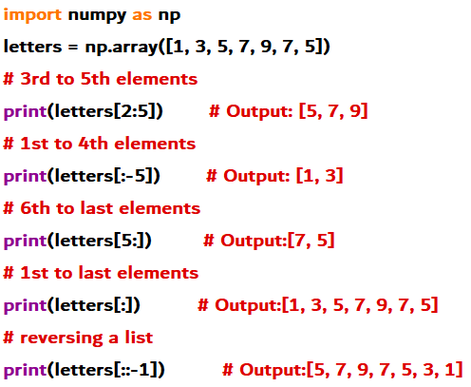
Slicing of a Matrix
Slicing of a one-dimensional NumPy array is similar to a list.
Sowmya Shah

Slide 26
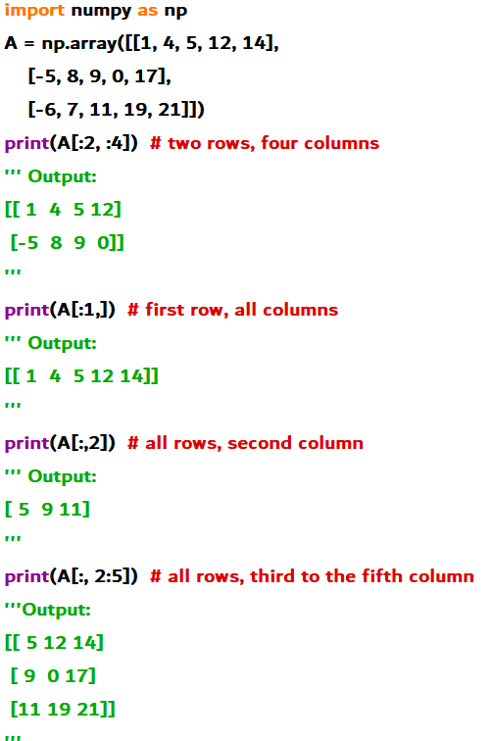
Slicing of a Matrix
Sowmya Shah

Slide 27
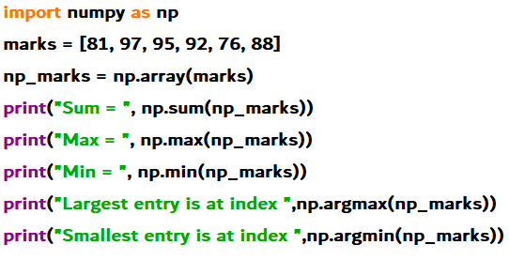
Numpy Functions

Slide 28
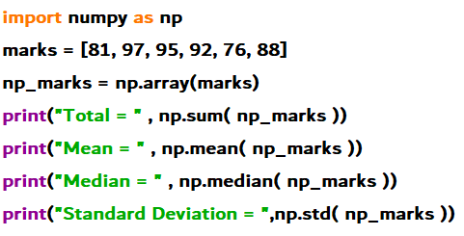
Numpy Functions

Slide 29
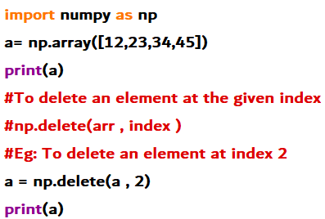
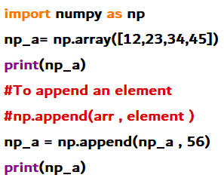
Adding and Removing
Sowmya Shah

Slide 30
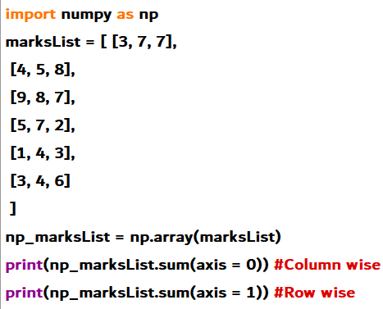
Matrix sum

Slide 31
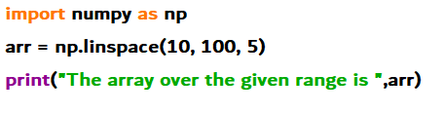
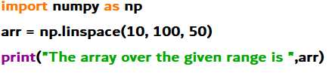
numpy.linspace()
With respect to interval, the numpy.linspace() function returns number spaces equally. The sample number is used instead of step in a manner similar to numpy.arange(). Syntax: numpy.linspace(start, stop, num = 50, endpoint = True, retstep = False, dtype = None)

Slide 32
What is SciPy?
SciPy is a scientific computation library that uses NumPy underneath.
SciPy stands for Scientific Python.
It provides more utility functions for optimization, stats, and signal processing.
Sowmya Shah

Slide 33
Why use SciPy?
SciPy contains varieties of sub packages which help to solve the most common issue related to Scientific Computation.
SciPy package in Python is the most used Scientific library only second to GNU Scientific Library for C/C++ or Matlab’s.
Easy to use and understand as well as fast computational power.
It can operate on an array of NumPy library.

Slide 34
Numpy VS SciPy
Numpy:
Numpy is written in C and use for mathematical or numeric calculation.
It is faster than other Python Libraries.
Numpy is the most useful library for Data Science to perform basic calculations.
Numpy contains nothing but array data type which performs the most basic operation like sorting, shaping, indexing, etc.
SciPy:
SciPy is built in top of the NumPy.
SciPy module in Python is a fully-featured version of Linear Algebra while Numpy contains only a few features.
Most new Data Science features are available in Scipy rather than Numpy.
SciPy is a library of algorithms and mathematical tools built to work with NumPy arrays. linear algebra - scipy.linalg statistics - scipy.stats sparse matrices - scipy.sparse
Sowmya Shah

Slide 35
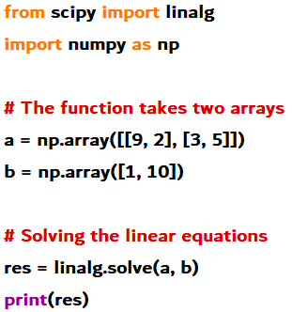
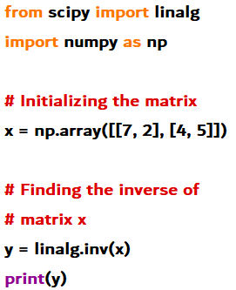
Scipy – linear algebra
Linear algebra
Inverse of matrix

Slide 36
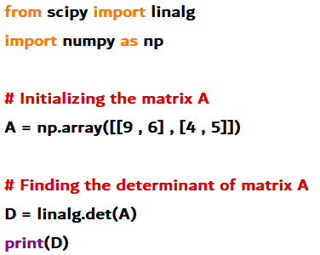
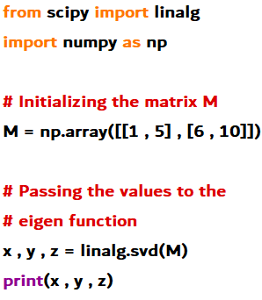
Scipy – linear algebra
Determinant of matrix
Eigen function

Slide 37
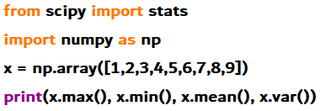
Scipy – Statistics
All of the statistics functions are located in the sub-package scipy.stats and a fairly complete listing of these functions can be obtained using info(stats) function.
The basic stats such as Min, Max, Mean and Variance takes the NumPy array as input and returns the respective results.

Slide 38
Scipy Sparse Matrix
A matrix is referred to as sparse if the majority of its elements have a value of 0. Using a sparse matrix as opposed to a basic matrix has two main advantages:Storage: Since there are fewer non-zero elements than zeroes, fewer elements can be stored in a given amount of memory. Computing time: By rationally creating a data structure that only traverses non-zero components, computing time can be reduced. Sparse matrices are frequently used in machine learning applications, including natural language processing and data encodings that map categories to counts (NLP).
SciPy, a Python package, provides utilities for both constructing sparse matrices using a variety of data structures and for converting dense matrices to sparse matrices. A compressed sparse row format sparse matrix is created using the function csr matrix(), and a compressed sparse column format sparse matrix is created using csc matrix().
Syntax: scipy.sparse.csr_matrix(shape=None, dtype=None)
Sowmya Shah

Slide 39
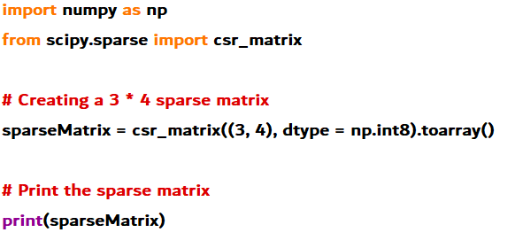
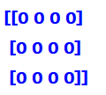
Scipy Sparse Matrix

Slide 40
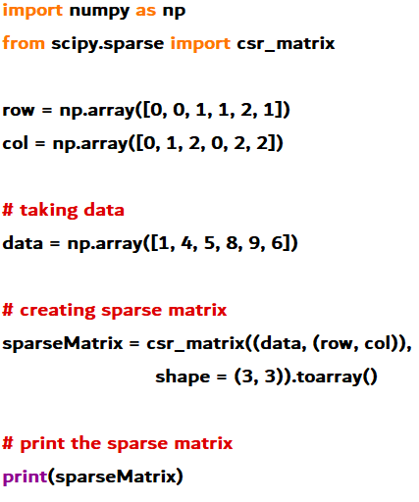
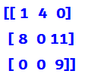
Scipy Sparse Matrix
Sowmya Shah

Slide 41
SciPy Constant
Numerous constants are provided in the scipy.constant package, which is widely used in the scientific community. We can import the necessary constants and use them as necessary from a variety of physical and mathematical constants and units.
Sample Code:
#Import pi constant from the scipy
from scipy.constants import pi
#Import pi from math package
from math import pi
#Comparing these two pi value
print("sciPy - pi Value = %.18f"%scipy.constants.pi)
print("math - pi Value = %.18f"%math.pi)
Output:
sciPy - pi Value = 3.141592653589793116
math - pi Value = 3.141592653589793116
Sowmya Shah

Slide 42
SciPy FFTpack
Fast Fourier Transformation is referred to as the FFT. The time-domain signal is transformed into the frequency domain using the Fourier transformation. It converts a waveform (a function or signal) into a new replacement waveform with sine and cosine characteristics. While the Laplace transform only translates aperiodic signals, it can convert periodic time signals.
Sample Code:
# importing the fft and inverse fft functions from fftpackage
from scipy.fftpack import fft
#Importing numpy
import numpy as np
#create an array with random n numbers
x = np.array([4.0, 2.0, 1.0, -3.0, 1.5])
#Applying the fft function
y = fft(x)
print(y)
Output:
[5.5 +0.j 6.69959347-2.82666927j 0.55040653+3.51033344j 0.55040653-3.51033344j 6.69959347+2.82666927j]
Sowmya Shah

Slide 43
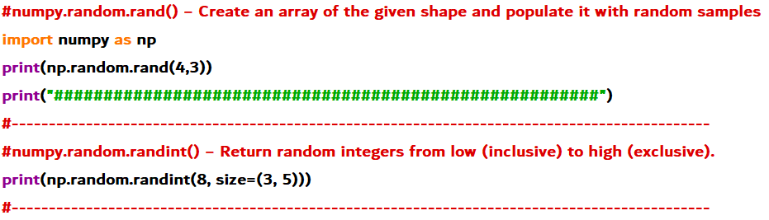
Generating random numbers using numpy
The random module in Numpy package contains many functions for generation of random numbers numpy.random.rand() − Create an array of the given shape and populate it with random samples.
Sowmya Shah

Slide 44
Did you know
The Pandas data manipulation package is based on NumPy, but instead of using arrays, it uses Series and DataFrames, two more essential data structures.
Along with NumPy, SciPy, and Matplotlib, the machine learning package Scikit-Learn is built on these three libraries.
Jim Hugunin originally developed Numeric, which was NumPy's forerunner, with assistance from a number of other programmers. Travis Oliphant developed NumPy in 2005 by heavily altering Numeric to incorporate capabilities of the rival Numarray. Also NumPy is OSS(Open-source software).
Summary
You can summarize an array or matrix with NumPy and SciPy, you can perform various operations such as calculating the sum, mean, minimum, maximum, variance, and standard deviation
reference links
https://en.wikipedia.org/wiki/NumPy
https://numpy.org/doc/stable/user/quickstart.html
https://www.javatpoint.com/numpy-tutorial
https://www.kaggle.com/code/mohtashimnawaz/numpy-with-jokes-and-funs
https://datascientest.com/en/numpy-the-python-library-in-data-science
Sowmya Shah

Slide 45
Questions
How can I make 1D, 2D, and 3D arrays with NumPy?
How does NumPy's np.mean() vary from np.average()?
What is difference between arr[:,0] and arr[:,[0]]
What does NumPy's vectorization mean to you?
Sowmya Shah
Notes:
Answer on this link:
https://www.interviewbit.com/numpy-interview-questions/#ndarrays-in-numpy
Search with:
What do you understand by Vectorization in NumPy?
How is arr[:,0] different from arr[:,[0]]
How is np.mean() different from np.average() in NumPy?

Slide 46
Thank You!
Sowmya Shah

